Slide 1
The Buffer Manager

Slide 2
The Buffer Manager
Provides the illusion of accessing and modifying disk pages in memory.
Transforms page requests (reads, writes) from upper levels into storage layer IO requests.

Slide 3
What does this illusion entail?
Address Translation: mapping disk page requests to a memory address location. The data must be in RAM for any processing to occur!
Reads/Writes → Disk IOs: work with the disk space manager to read in the page but also to write out modified “dirty” pages back to disk
Resource Allocation (Deception): small buffer, large disk, many page requests. Deciding which pages to remove from memory to accommodate new page requests.

Slide 4
FrameID | PageID | Dirty? | Pin Count
0
1
2
3
4
5
6
7
8
9
Buffer pool: Large range of memory, malloced at DBMS server boot time. Divided into frames. Each frame can hold a page from disk.
Page table: Small array malloced at DBMS server boot time to keep track of the buffer state.
Hash table index on PageID: to get the frame in which the page is loaded.
The Buffer Pool
& The Page Table

Slide 5
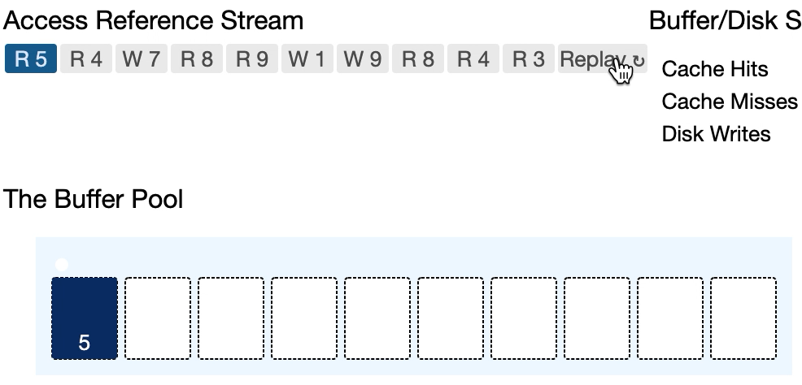
FrameID | PageID | Dirty? | Pin Count
0 | 5 | 0 | 0
1 | 4 | 0 | 0
2 | 7 | 1 | 1
3 | 8 | 0 | 1
4 | 9 | 1 | 2
5 | 1 | 1 | 0
6 | 3 | 0 | 0
7
8
9
Read & write requests arrive from different transactions. Each requestor pins while in use and unpins pages immediately after.
Dirty bit
Pin count
Why do we use a dirty bit?
Why do we store a pin count?
Disk Pages

Slide 6
c
c
c
Notes:
Why do requestors pin and unpin immediately after use?

Slide 7
c
c
c
c
c

Slide 8
c
c
Notes:
The buffer manager cannot replace a pinned page!

Slide 9
Goal: Minimize stalls from reading data from disk!
More time

Slide 11
Page Replacement Policies

Slide 12
Minimizes Cache Misses
If you knew the future, you could optimize the choice of pages to keep/replace to minimize your disk IOs
The implementation of the policy needs to be fast: cannot afford to wait for an expensive algorithm to run.
You need to minimize the meta-data you store for each page as well.
Minimizes cache misses!
Minimal overhead
Minimal Overhead
Design Goals of a Page Replacement Policy

Slide 13
LRU & CLOCK

Slide 14
Least Recently Used (LRU)
Minimizes Cache Misses
Intuition: if we haven’t accessed a page in while, we probably won’t access it again. Why? Temporal locality
Maintain a timestamp of when each page was last accessed.
When the DBMS needs to evict a page, select the one with the oldest timestamp.
Minimal Overhead
Use a min-heap data structure to efficiently search for the “least recently used” page to replace.

Slide 15
LRU in action
FrameID | PageID | Dirty? | Pin Count | Last Accessed
0 | 0 | 0 | 0 | 16
1 | 1 | 0 | 0 | 19
2 | 2 | 0 | 0 | 23
3 | 3 | 0 | 0 | 27
4 | 4 | 1 | 0 | 28
5 | 5 | 1 | 0 | 32
6 | 6 | 1 | 0 | 36
7 | 7 | 1 | 0 | 37
8 | 8 | 0 | 0 | 39
9 | 9 | 1 | 0 | 40

Slide 16
LRU in action
FrameID | PageID | Dirty? | Pin Count | Last Accessed
0 | 10 | 1 | 0 | 45
1 | 11 | 0 | 0 | 53
2 | 12 | 0 | 0 | 57
3 | 13 | 0 | 0 | 59
4 | 14 | 0 | 0 | 62
5 | 5 | 1 | 0 | 32
6 | 6 | 1 | 0 | 36
7 | 7 | 1 | 0 | 37
8 | 8 | 0 | 0 | 39
9 | 9 | 1 | 0 | 40

Slide 17
LRU in action
FrameID | PageID | Dirty? | Pin Count | Last Accessed
0 | 10 | 1 | 0 | 45
1 | 11 | 0 | 0 | 53
2 | 12 | 0 | 0 | 57
3 | 13 | 0 | 0 | 59
4 | 14 | 0 | 0 | 62
5 | 5 | 1 | 0 | 68
6 | 6 | 1 | 0 | 69
7 | 7 | 1 | 0 | 71
8 | 8 | 0 | 0 | 73
9 | 9 | 1 | 0 | 76

Slide 18
LRU in action
FrameID | PageID | Dirty? | Pin Count | Last Accessed
0 | 15 | 1 | 0 | 81
1 | 16 | 0 | 0 | 84
2 | 17 | 0 | 0 | 88
3 | 18 | 0 | 0 | 93
4 | 19 | 0 | 0 | 94
5 | 5 | 1 | 0 | 68
6 | 6 | 1 | 0 | 69
7 | 7 | 1 | 0 | 71
8 | 8 | 0 | 0 | 73
9 | 9 | 1 | 0 | 76

Slide 19
LRU in action
FrameID | PageID | Dirty? | Pin Count | Last Accessed
0 | 10 | 1 | 0 | 81
1 | 11 | 0 | 0 | 84
2 | 12 | 0 | 0 | 88
3 | 13 | 0 | 0 | 93
4 | 14 | 0 | 0 | 94
5 | 5 | 1 | 0 | 100
6 | 6 | 1 | 0 | 102
7 | 7 | 1 | 0 | 106
8 | 8 | 0 | 0 | 109
9 | 9 | 1 | 0 | 111

Slide 20
LRU → CLOCK
LRU --- Minimal Overhead?
Do not store a separate timestamp per page!
Just store a reference bit.
Scan through pages in the page table as if they were in a circular buffer with a “clock hand”:
If ref bit is 1, set to 0
If ref bit is 0, evict!
Approximate LRU
What if instead of using 4-8 bytes to store time, we used a single bit

Slide 21
FrameID | PageID | Dirty? | Pin Count | Ref Bit
0 | 0 | 1 | 0 | 1
1 | 1 | 0 | 0 | 1
2 | 2 | 0 | 0 | 1
3 | 3 | 0 | 0 | 1
4 | 4 | 0 | 0 | 1
5 | 5 | 1 | 0 | 1
6 | 6 | 1 | 0 | 1
7 | 7 | 1 | 0 | 1
8 | 8 | 0 | 0 | 1
9 | 9 | 1 | 0 | 1
CLOCK in action

Slide 22
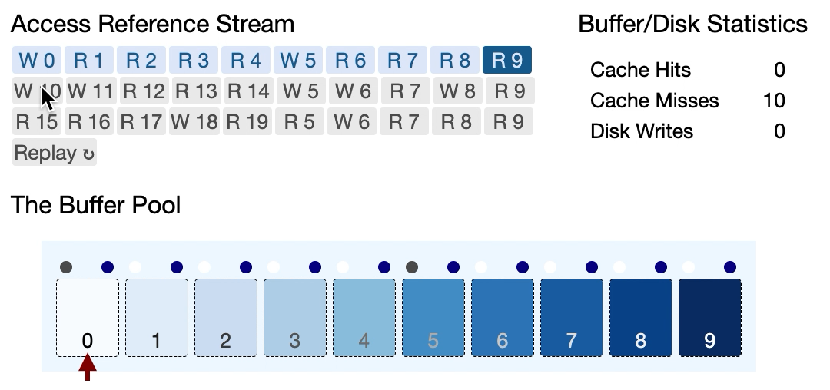
FrameID | PageID | Dirty? | Pin Count | Ref Bit
0 | 0 | 1 | 0 | 1
1 | 1 | 0 | 0 | 1
2 | 2 | 0 | 0 | 1
3 | 3 | 0 | 0 | 1
4 | 4 | 0 | 0 | 1
5 | 5 | 1 | 0 | 1
6 | 6 | 0 | 0 | 1
7 | 7 | 0 | 0 | 1
8 | 8 | 0 | 0 | 1
9 | 9 | 0 | 0 | 1
Ref Bit
0
0
0
0
0
0
0
0
0
0
0 | 10 | 1 | 0 | 1
CLOCK in action

Slide 23
FrameID | PageID | Dirty? | Pin Count | Ref Bit
0 | 10 | 1 | 0 | 1
1 | 11 | 1 | 0 | 1
2 | 12 | 0 | 0 | 1
3 | 13 | 0 | 0 | 1
4 | 14 | 0 | 0 | 1
5 | 5 | 1 | 0 | 1
6 | 6 | 1 | 0 | 1
7 | 7 | 0 | 0 | 1
8 | 8 | 1 | 0 | 1
9 | 9 | 0 | 0 | 1
CLOCK in action

Slide 24
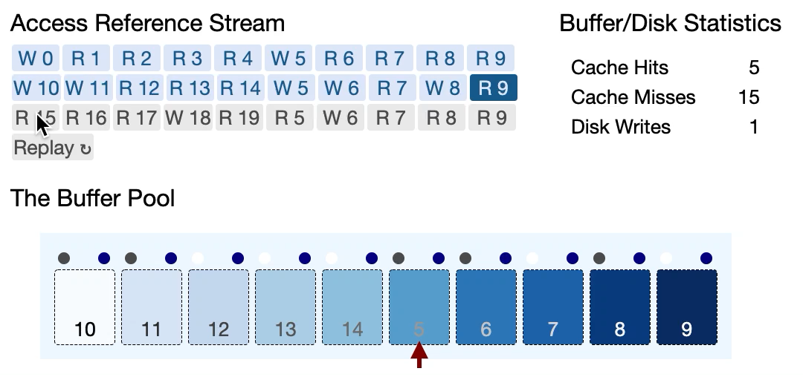
FrameID | PageID | Dirty? | Pin Count | Ref Bit
0 | 10 | 1 | 0 | 1
1 | 11 | 1 | 0 | 1
2 | 12 | 0 | 0 | 1
3 | 13 | 0 | 0 | 1
4 | 14 | 0 | 0 | 1
5 | 5 | 1 | 0 | 1
6 | 6 | 1 | 0 | 1
7 | 7 | 0 | 0 | 1
8 | 8 | 1 | 0 | 1
9 | 9 | 0 | 0 | 1
0
0
0
0
0
0
0
0
0
0
5 | 15 | 0 | 0 | 1
CLOCK in action

Slide 25
FrameID | PageID | Dirty? | Pin Count | Ref Bit
0 | 5 | 1 | 0 | 1
1 | 6 | 1 | 0 | 1
2 | 7 | 0 | 0 | 1
3 | 8 | 0 | 0 | 1
4 | 9 | 0 | 0 | 1
5 | 15 | 1 | 0 | 1
6 | 16 | 1 | 0 | 1
7 | 17 | 0 | 0 | 1
8 | 18 | 1 | 0 | 1
9 | 19 | 0 | 0 | 1
CLOCK in action

Slide 26
LRU or CLOCK
Sequential Flooding
A query sequentially scans a large file of many pages.
The buffer is polluted with pages that are read once and then never again …
select * from R where id = 12;
Minimizes Cache Misses
select sum(a) from LargeTable;
select * from R where id = 18;
Intuition: if we haven’t accessed a page in while, we probably won’t access it again.
or will be read again but soon after eviction in the case of repeated scans
select * from R, Y where R.id = Y.id;
Certain join implementations (e.g. nested loop join) repeatedly scan the inner table.
Minimizes cache misses for some workloads

Slide 27
MRU

Slide 28
Most Recently Used (LRU)
Minimizes Cache Misses for Repeated Scans
Maintain pages in order of last access.
When the DBMS needs to evict a page, select the one with the most recent timestamp!
Intuition: The pages that we just read in are least likely to be read again (at least for a while!)

Slide 29
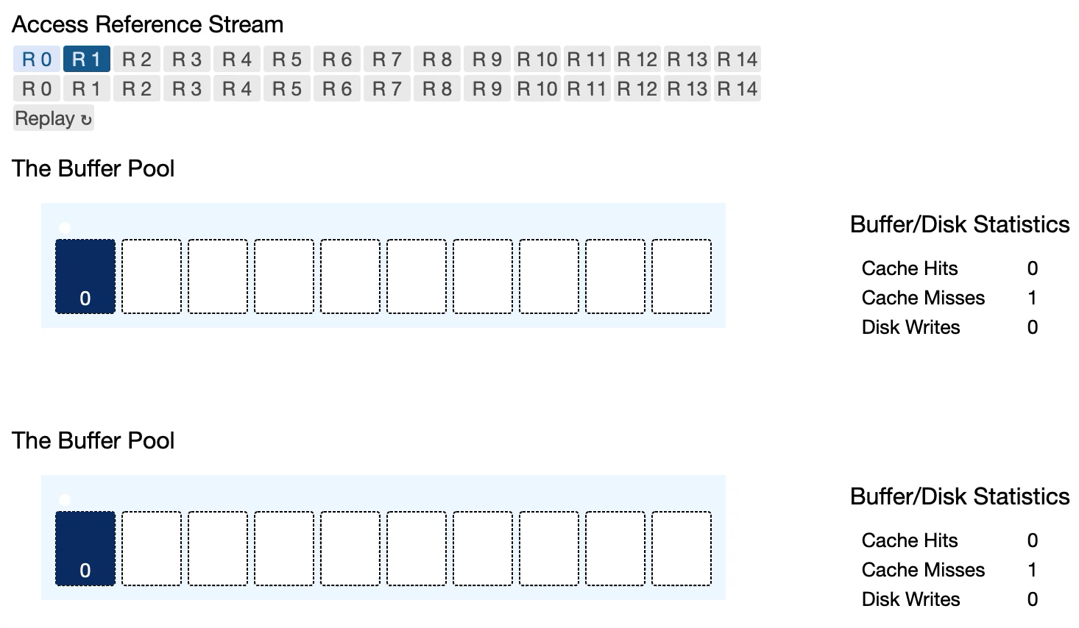
Repeated Scans
MRU vs. LRU

Slide 31
Policy Optimizations

Slide 32
Likelihood of Re-access
LRU-K (Often LRU-2)
Multiple Buffer Pools & Hints
Prefetching
Multiple buffer pools:
Per type (index vs. database table file pools)
Per transaction/query/database
Different policies per pool.
DBMS can provide hints on which pages to keep or to evict.
Top levels or root of an index are important, but leaf nodes may not be frequently accessed
For a given query, we can predict the access patten. So prefetch the pages into the buffer even before they are requested.
For example:
select sum(a) from R;
is a sequential scan so prefetch a few pages at a time.
Maintain the last K timestamps a page was accessed.
Compute the interval between them
Estimate the next time a page will be accessed.
Keep pages that will be accessed soon.

Slide 33
Keep it dirty / Background writes
Scan Sharing
Query A is scanning relation R and has scanned and evicted 5 pages already
Query B arrives and, also wants to scan relation R.
Query B jumps in with A and starts at A’s current cursor sharing the scan.
Query B then requests the first 5 pages that it missed.
When choosing which page to evict, you can skip “dirty” pages --- the lazy approach saves you a write during a page request.
A background thread can flush the dirty pages every now & then to disk giving you more clean pages on page requests that don’t require “write”.
We will examine writes again when looking at recovery and concurrency control.

Slide 34
OS & DBMS Buffer Interactions

Slide 35
Portability: Different FS cache use different page replacement policies. This leads to different performance on different OS and a DBMS needs better control.
Force writes: We will see later that recovery protocols require the DBMS to enforce page flushes to disk and the OS may delay such requests.
Prefetching: DBMS has more information on the access patterns of different queries and benefits from prefetching and page hints. The OS FS is general purpose.
Most disk IO requests go through the OS. The OS maintains its own filesystem cache.
Why can’t we just rely on the FS cache?

