Slide 1
Sorting & Hashing

Slide 2
Where we are right now?

Slide 3
Building blocks: Sorting & Hashing
Why are they building blocks?
Rendezvous
  Duplicate elimination:
    select DISTINCT a
  Join processing
    select R JOIN S on a
  Grouping & Aggregations:
    select SUM(a) from R GROUP BY b
Ordering (Sorting)
  Ordered Result
    select * from R ORDER BY A
  Bulk Loading
Why are they special in a DBMS?
Well-studied in-memory algorithms!
  Sorting: Quick-, Merge-, Radix-, …
  Hashing
But … tables don’t fit in memory
  Can’t rely on virtual memory
  Disk-oriented – minimize IO
  Prefer sequential IOs

Slide 4
What if we have an index?
Can we use it for sorting?
It depends!

Slide 6
2-Way Merge Sort

Slide 7
2-Way External Merge Sort Trace
Unsorted file on disk
N = 15 pages
Buffer Pool Size = 3

Slide 8
2-Way External Merge Sort Trace
Unsorted file on disk
N = 15 pages
Pass 0 – Streaming Pass
15 sorted runs of length 1
Buffer Pool Size = 3

Slide 9
2-Way External Merge Sort Trace
Unsorted file on disk
N = 15 pages
Pass 0 – Streaming Pass
15 sorted runs of length 1
Pass 1 – Merge Pass
8 sorted runs of length 2
Buffer Pool Size = 3

Slide 10
2-Way External Merge Sort Trace
Unsorted file on disk
N = 15 pages
Pass 0 – Streaming Pass
15 sorted runs of length 1
Pass 1 – Merge Pass
8 sorted runs of length 2
Pass 2 – Merge Pass
4 sorted runs of length 4
Buffer Pool Size = 3

Slide 11

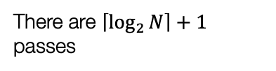
2-Way External Merge Sort Trace
Unsorted file on disk
N = 15 pages
Pass 0 – Streaming Pass
15 sorted runs of length 1
Pass 1 – Merge Pass
8 sorted runs of length 2
Pass 2 – Merge Pass
4 sorted runs of length 4
Pass 3 – Merge Pass
2 sorted runs of length 8
Pass 4 – Merge Pass
1 sorted run of length 15
Buffer Pool Size = 3
Each pass costs 2N IOs
Read the file + Sort + Write the file
There are $\left\lceil \log_{2}{N}\right\rceil +1$ passes
Total Cost: $2N × \left(\left\lceil \log_{2}{N}\right\rceil +1\right)$ IOs
Notes:
Why are there are log2N passes … at each pass, we double up the length of our sorted run!

Slide 12
Prefetch these
Prefetch the next run in the background while the system is processing this run.
Reduces the wait time for IO requests.
Requires support for asynchronous IO, multi-threading: the buffer manager brings in the next run while the sorting thread processes the pages currently in the buffer.
Double Buffering
What if B > 3 buffer pages?

Slide 14
K-Way Merge Sort

Slide 15

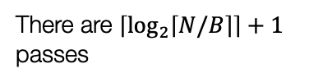


K-Way External Merge Sort Trace: Optimizing the Streaming Phase
Unsorted file on disk
N = 15 pages
Run length $≤ B = 3$
Pass 0 – Streaming Pass
5 sorted runs of length 3
Pass 1 – Merge Pass
3 sorted runs of length 6
Pass 2 – Merge Pass
2 sorted runs of length 12
Pass 3 – Merge Pass
1 sorted runs of length 15
Each pass costs 2N IOs
Read the file + Sort + Write the file
There are $\left\lceil \log_{2}{N}\right\rceil +1$ passes
Buffer Pool Size = 3
There are $\left\lceil \log_{2}\left\lceil N/B\right\rceil \right\rceil +1$ passes
Total Cost: $2N × \left(\left\lceil \log_{2}\left\lceil N/B\right\rceil \right\rceil +1\right)$ IOs

Slide 16

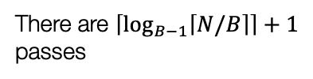
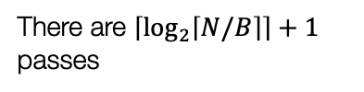

K-Way External Merge Sort Trace: Making use of more buffers!
Unsorted file on disk
N = 15 pages
Run length $≤ B =4$
Pass 0 – Streaming Pass
4 sorted runs of length 4
Run length $≤ B(B−1) =4∗3 =12$
Pass 1 – Merge Pass
2 sorted runs of length 12
Run length $≤ B\left(B−1\right)∗\left(B−1\right)=B{\left(B−1\right)}^{p}= B{\left(B−1\right)}^{2} =4∗3∗3 =36$
Pass 2 – Merge Pass
1 sorted run of length 15
Each pass costs 2N IOs
Read the file + Sort + Write the file
There are $\left\lceil \log_{2}\left\lceil N/B\right\rceil \right\rceil +1$ passes
Buffer Pool Size = 4
There are $\left\lceil \log_{B−1}\left\lceil N/B\right\rceil \right\rceil +1$ passes
Total Cost: $2N × \left(\left\lceil \log_{B−1}\left\lceil N/B\right\rceil \right\rceil +1\right)$ IOs

Slide 17
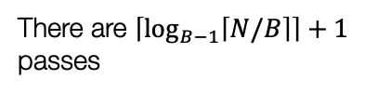

K-Way External Merge Sort Trace: Making use of more buffers!
Unsorted file on disk
N = 15 pages
Pass 0 – Streaming Pass
4 sorted runs of length 5
Pass 1 – Merge Pass
2 sorted runs of length 12
Buffer Pool Size = 5
Each pass costs 2N IOs
Read the file + Sort + Write the file
There are $\left\lceil \log_{B−1}\left\lceil N/B\right\rceil \right\rceil +1$ passes
Total Cost: $2N × \left(\left\lceil \log_{B−1}\left\lceil N/B\right\rceil \right\rceil +1\right)$ IOs

Slide 18
# of pages in a file to sort (N) | Buffer Size (B)
 | 3 | 5 | 9 | 17 | 129 | 257
100 | 7 | 4 | 3 | 2 | 1 | 1
1,000 | 10 | 5 | 4 | 3 | 2 | 2
10,000 | 13 | 7 | 5 | 4 | 2 | 2
100,000 | 17 | 9 | 6 | 5 | 3 | 3
1,000,000 | 20 | 10 | 7 | 5 | 3 | 3
10,000,000 | 23 | 12 | 8 | 6 | 4 | 3
100,000,000 | 26 | 14 | 9 | 7 | 4 | 4
1,000,000,000 | 30 | 15 | 10 | 8 | 5 | 4
# of Passes of
External Sort

Slide 19
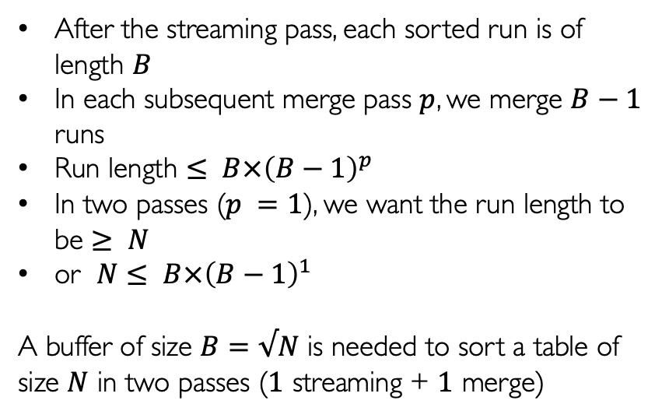
File Size |  | 2- Pass Buffer Size
Pages (N) | Bytes | Pages (B) | Bytes
100 | 400 KB | 10 | 40 KB
1,000 | 4 MB | 32 | 128 KB
10,000 | 40 MB | 100 | 400KB
100,000 | 400 MB | 317 | 1.27 MB
1,000,000 | 4 GB | 1000 | 4 MB
10,000,000 | 40 GB | 3163 | 12.65 MB
100,000,000 | 4000 GB | 10000 | 40 MB
1,000,000,000 | 4 TB | 31623 | 126.5 MB
2-Pass External Sort
After the streaming pass, each sorted run is of length $B$
In each subsequent merge pass $p$, we merge $B−1$ runs
Run length $≤ B×{\left(B−1\right)}^{p}$
In two passes ($p =1$), we want the run length to be $≥ N$
or $N≤ B×{\left(B−1\right)}^{1}$
A buffer of size $B=√N$ is needed to sort a table of size $N$ in two passes ($1$ streaming + $1$ merge)

Slide 21
External Hashing
When order isn’t important!

Slide 22
External Hashing: Streaming Phase - Partition
1
Buffer Pool Size B
1
2
2
3
4
Input
3
4
B-1
N
File Size N

Slide 23

External Hashing: Streaming Phase - Partition
1
Buffer Pool Size B
1
1
The streaming partition phase produces partitions that have:
Many different values
Duplicate values that are not contiguous
Different sizes!
1
2
2
Partitioning hash function: h_{p}
3
2
3
3
4
3
4
Input
4
Cost: $2N$
B-1
B-1
N
File Size N
B-1 partitions of size ~N/(B-1)

Slide 24

External Hashing: ReHash
Assume each partition
P_{i} <= B
Buffer Pool
h_{r} has to be different from h_{p}
Each in-memory hash table:
Different values in different buckets modulo collisions
Duplicate values (same key) stored contiguously in the same bucket
On processing a partition spill out the hash table to disk and process the next partition (note partitions are disjoint!)
P₁
Rehashing function: h_{r}
B
Fully hashed table
P₂
P₃
P₄
P_{B-1}
Cost: $2N$
B-1 partitions of size ~N/(B-1)
Create in-memory hash table for each partition

Slide 25
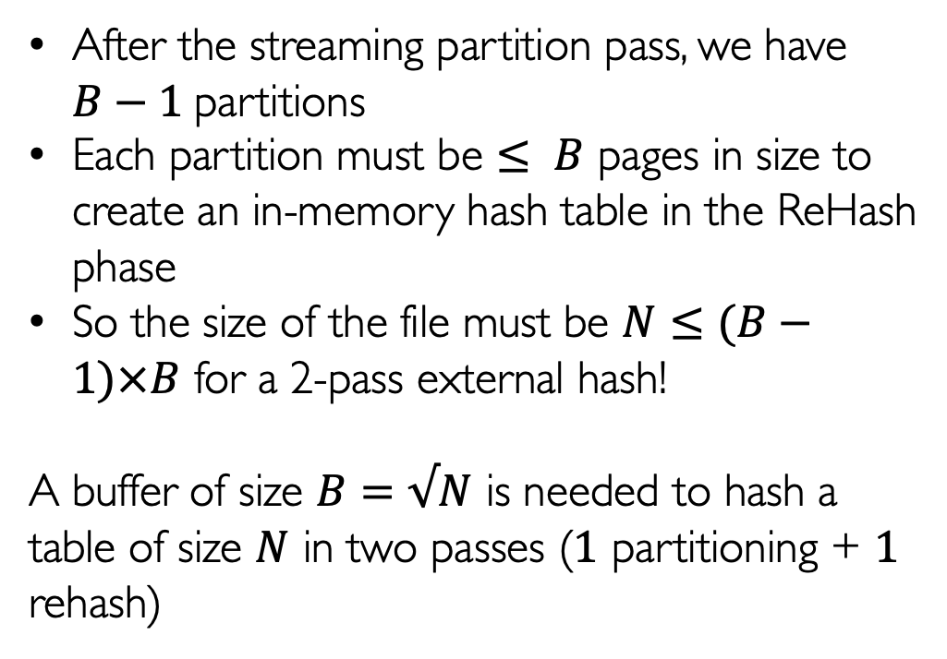
After the streaming partition pass, we have $B−1$partitions
Each partition must be $≤ B$ pages in size to create an in-memory hash table in the ReHash phase
So the size of the file must be $N≤(B−1)×B$ for a 2-pass external hash!
A buffer of size $B=√N$ is needed to hash a table of size $N$ in two passes ($1$ partitioning + $1$ rehash)
2-Pass External Hash

Slide 26

Recursive Partitioning
What if the size of a partition > B?
What about too many duplicates?
What about too many collisions?
Buffer Pool Size B
1
P_{1,1}
Partitioning hash function: h_{p’}
2
P_{1,2}
Suppose P₁ > B
h_{p} $≠$h_{p’}
3
P_{1,3}
Input
P₁
4
P_{1,4}
B-1
P_{1.B-1}

Slide 28
The Sort-Hash Duality

Slide 29
External Sorting
External Hashing
1
1
1
2
1
2
3
3
3
4
3
4
Streaming Sort
(Conquer)
Merge Pass
(Combine)
Streaming Partition
(Divide)
ReHash Pass
(Conquer)

Slide 30
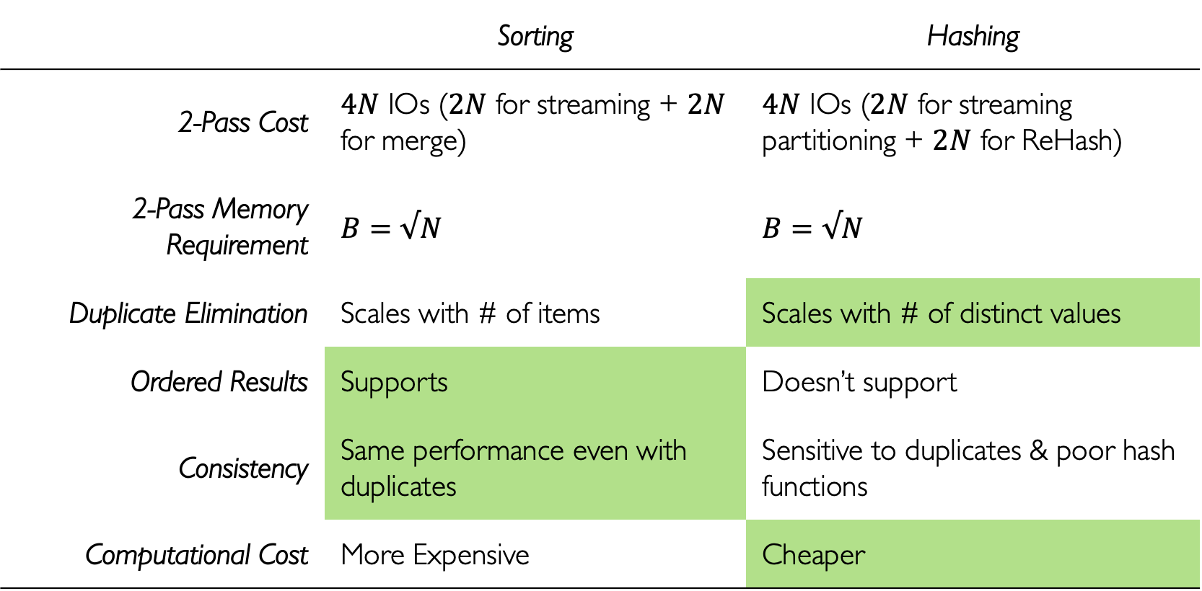
 | Sorting | Hashing
2-Pass Cost | $4N$ IOs ($2N$ for streaming + $2N$ for merge) | $4N$ IOs ($2N$ for streaming partitioning + $2N$ for ReHash)
2-Pass Memory Requirement | $$B=√N$$ | $$B=√N$$
Duplicate Elimination | Scales with # of items | Scales with # of distinct values
Ordered Results | Supports | Doesn’t support
Consistency | Same performance even with duplicates | Sensitive to duplicates & poor hash functions
Computational Cost | More Expensive | Cheaper
Comparing Sorting with Hashing

Slide 31
Streaming Sort Pass – can eliminate some duplicates
Merge Pass – skipping over duplicates
Partitioning Pass – can eliminate some duplicates
ReHash Pass – If entry in hash table, skip, else insert
Duplicate Elimination
If the file is sorted, scan and skip duplicates
If the file is hashed, the result is the hash-table
Grouping & Aggregation
Maintain a running aggregate for each group key
MIN, MAX, COUNT, SUM → just update the aggregate
AVG → update two aggregates: SUM, COUNT and then compute the AVG
Joins
Sort-Merge Join
Hash Join
Support for higher-order operations

