Slide 1
Query Processing

Slide 2







SQL Query
Logical Query Plan
Optimized Physical Query Plan
$$τ_{b}$$
$$τ_{b}$$
External merge
sort
select * from R
where a > 5
order by b;
$$σ_{a>5}\left(τ_{b}(R)\right)$$
$$σ_{a>5}$$
$$σ_{a>5}$$
selection
Query Parser
parses/rewrites plan
Query Optimizer
selects operator
$$R$$
$$R$$
Heap Scan
Each operator is a subclass of an iterator
Console
Query Executor
instantiates operators
abstract class iterator
void setup(List<Iterator> children);
void init(args);
tuple next();
void close();
}
Sort (2-pass)
Select
calls “setup”
Heap Scan(R)
Query Processing

Slide 3
Each operator is a subclass of an iterator
abstract class iterator
void setup(List<Iterator> children);
void init(args);
tuple next();
void close();
}
Console
for each child in children:
child.init()
child.next()
Blocking
Sort (2-pass)
child.init()
child.next()
Streaming
Select
child.init()
child.next()
Streaming
Heap Scan(R)
Query Processing – Iterator Model

Slide 4
new(function predicate): //constructor given predicate
p = predicate; //{return tuple.getValue(“a”)>5}
init():
child.init(); //Initializes the heap scan op
current = null;
next():
while (current != EOF && !p(current)){
current = child.next();
}
return current;
Select
Heap Scan(R)
init(): //the op was setup to access the heap file
current_page = file.getPage(0);
current_slot = current_page.getSlot(0);
next():
if(current_page == null) return EOF;
current = current_slot.getTuple();
current_slot.next();
if(current_slot == null):
current_page.next();
if(current_page != null):
current_slot = current_page.getSlot(0);
return current;
Slide Credit: Berkeley CS-186 Public Edition

Slide 5
Sort (2-pass)
init():
child.init();
repeatedly call child.next() to generate sorted
runs on disk until EOF
open each sorted run / load into input buffer
next():
output = min tuple across all input buffers (remove min tuple)
if no tuples remain:
return EOF;
if min tuple was last one in its buffer:
fetch next page from that run into buffer;
return output;
Select
Heap Scan(R)
Slide Credit: Berkeley CS-186 Public Edition

Slide 7
The Join Operator

Slide 8

What is a Join?
$R⋈_{σ}S=σ\left(R × S\right)$

Slide 9






Loans ($R$ has $n$ rows)
Students ($S$ has $m$ rows)
sid | eid | date | duration | …
72 | 981 | 3/8/20 | 2 weeks
76 | 786 | 3/18/21 | 2 days
sid | name | major | …
72 | Ibn Sina | Bio
73 | Plato | Phil
76 | Al Khawarizmi | CS
Cartesian Product $×$
$$Loans × Students$$
sid | eid | date | duration | sid | name | major | …
72 | 981 | 3/8/20 | 2 weeks | 72 | Ibn Sina | Bio
72 | 981 | 3/8/20 | 2 weeks | 73 | Plato | Phil
72 | 981 | 3/8/20 | 2 weeks | 76 | Al Khawarizmi | CS
76 | 786 | 3/18/21 | 2 days | 72 | Ibn Sina | Bio
76 | 786 | 3/18/21 | 2 days | 73 | Plato | Phil
76 | 786 | 3/18/21 | 2 days | 76 | Al Khawarizmi | CS
$$R×S$$
Each row in R is paired with each row in S to produce $nm$ rows.

Slide 10


Loans ($R$ has $n$ rows)
Students ($S$ has $m$ rows)
sid | eid | date | duration | …
72 | 981 | 3/8/20 | 2 weeks
76 | 786 | 3/18/21 | 2 days
sid | name | major | …
72 | Ibn Sina | Bio
73 | Plato | Phil
76 | Al Khawarizmi | CS
Join $⋈$
$Loans⋈ Students≡σ_{sid=sid}\left(Loans ×Students\right)$
$$R⋈_{R.sid=S.sid}S$$
sid | eid | date | duration | sid | name | major | …
72 | 981 | 3/8/20 | 2 weeks | 72 | Ibn Sina | Bio
72 | 981 | 3/8/20 | 2 weeks | 73 | Plato | Phil
72 | 981 | 3/8/20 | 2 weeks | 76 | Al Khawarizmi | CS
76 | 786 | 3/18/21 | 2 days | 72 | Ibn Sina | Bio
76 | 786 | 3/18/21 | 2 days | 73 | Plato | Phil
76 | 786 | 3/18/21 | 2 days | 76 | Al Khawarizmi | CS
sid | eid | date | duration | sid | name | major | …
72 | 981 | 3/8/20 | 2 weeks | 72 | Ibn Sina | Bio
76 | 786 | 3/18/21 | 2 days | 76 | Al Khawarizmi | CS
Each row in R is matched to a row in S that satisfies the join condition.

Slide 11
The Join Analysis Set Up
Left / Outer
Right / Inner
Relation R
Relation S
1
Buffer Pool Size B
1
Each table is broken down into pages.
Each table has a join key attribute and a value that could be a record id, or a tuple, etc. We only show the join keys.
When computing join costs, we will ignore the output costs:
For now, we don’t know how many tuples will join
Across all implementations, the output cost is the same
a, …
a, …
a, …
a, …
b, …
1
…
b, …
2
2
3
3
4
4
…
B
N
M
# of pages: N
# of tuples: n
# of pages: M
# of tuples: m

Slide 12
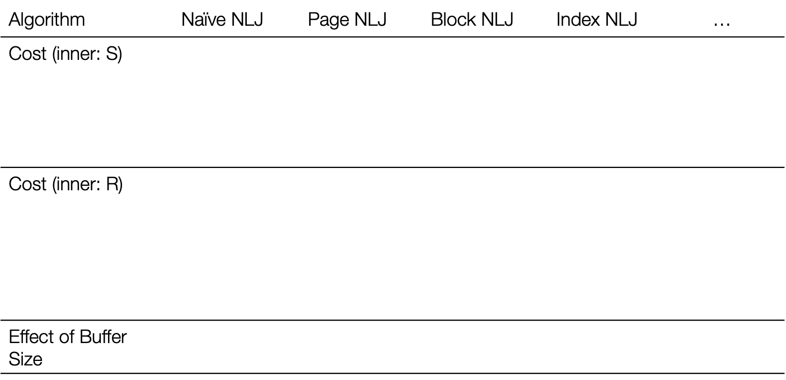

The Equipment Loans Application
R – Loans
(sid, eid, date, duration, …)
$$N = 500$$
$$n = 40,000$$
Tuples per page: $80$
S – Students
(sid, name, major, …)
$$M = 1000$$
$$m = 100,000$$
Tuples per page: $100$
B buffer size
$$B≤102$$
Algorithm | Naïve NLJ | Page NLJ | Block NLJ | Index NLJ | …
Cost (inner: S) | $$M+mN$$
 | $$500+40,000×1000=40000500$$
Cost (inner: R) | $$N+nM$$
 | $$1000+100,000×500=50001000$$
Effect of Buffer Size | $$B > 500 →N + M$$

Slide 13
Nested Loops Join

Slide 14
Naïve Nested Loops Join
S
# of pages: M
# of tuples: m
R
# of pages: N
# of tuples: n
for each tuple r in R:
for each tuple s in S:
if(key(r) == key(s)):
emit(r, s)
1
1
1
1
1
z, …
z, …
z, …
z, …
z, …
f, …
f, …
f, …
1
f, …
1
f, …
a, …
a, …
Buffer Pool Size B
r, …
r, …
r, …
r, …
b, …
r, …
b, …
p, …
p, …
2
2
2
2
2
a, …
a, …
a, …
a, …
a, …
1
2
a, …
a, …
w, …
p, …
p, …
d, …
d, …
d, …
d, …
2
d, …
2
w, …
w, …
b, …
w, …
w, …
w, …
w, …
b, …
w, …
b, …
w, …
p, …
a, …
3
3
3
3
c, …
3
c, …
p, …
p, …
p, …
p, …
p, …
x, …
x, …
x, …
x, …
3
x, …
a, …
3
p,p,…
a,a,…
f, …
f, …
f, …
f, …
p, …
a,a,…
f, …
w,w…
4
4
4
4
x, …
4
p, …
p, …
p, …
p, …
p,p,…
p, …
c, …
c, …
c, …
c, …
c, …
a, …
a, …
a, …
a, …
a, …
3
3
3
3
a,a …
p,p …
a,a …
p,p …
a,a …
w,w…
a,a…
x,x…
p,p …
c,c …
p,p …

Slide 15
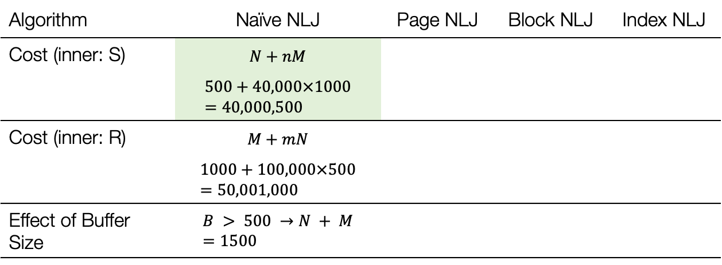
Cost Analysis – Naïve NLJ
R – Loans
(sid, eid, date, duration, …)
$$N = 500$$
$$n = 40,000$$
Tuples per page: $80$
S – Students
(sid, name, major, …)
$$M = 1000$$
$$m = 100,000$$
Tuples per page: $100$
B buffer size
$$B≤102$$
Algorithm | Naïve NLJ | Page NLJ | Block NLJ | Index NLJ
Cost (inner: S) | $$N+nM$$
 | $$500+40,000×1000=40,000,500$$
Cost (inner: R) | $$M+mN$$
 | $$1000+100,000×500=50,001,000$$
Effect of Buffer Size | $$B > 500 →N + M=1500$$
Does it matter what the inner relation is?
Yes! We want the larger relation inside.
Poor implementation
We could match multiple tuples at a time for pages that are loaded

Slide 16
Page Nested Loops Join
S
# of pages: M
# of tuples: m
R
# of pages: N
# of tuples: n
for each page p_{r} in R:
for each page p_{s} in S:
for each tuple r in p_{r}:
for each tuple s in p_{s}:
if(key(r) == key(s)):
emit(r, s)
1
1
z, …
z, …
1
f, …
1
f, …
a, …
a, …
Buffer Pool Size B
r, …
b, …
r, …
b, …
p, …
p, …
2
2
a, …
a, …
1
2
a, …
a, …
p, …
p, …
d, …
2
d, …
2
w, …
w, …
b, …
w, …
b, …
w, …
b, …
p, …
a, …
3
c, …
3
c, …
p, …
p, …
x, …
3
x, …
a, …
3
p,p,…
a,a,…
f, …
p, …
p,p,…
f, …
4
x, …
4
p, …
a,a,…
p, …
c, …
c, …
a, …
a, …
3
3
3
3
a,a …
p,p …
a,a …
a,a …
p,p …
w,w…
p,p…
p,p…
a,a …
c,c …
x,x …

Slide 17
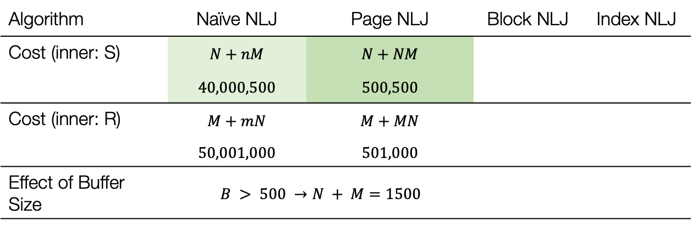
Cost Analysis – Page NLJ
R – Loans
(sid, eid, date, duration, …)
$$N = 500$$
$$n = 40,000$$
Tuples per page: $80$
S – Students
(sid, name, major, …)
$$M = 1000$$
$$m = 100,000$$
Tuples per page: $100$
B buffer size
$$B≤102$$
Algorithm | Naïve NLJ | Page NLJ | Block NLJ | Index NLJ
Cost (inner: S) | $$N+nM$$ | $$N+NM$$
 | $$40,000,500$$ | $$500,500$$
Cost (inner: R) | $$M+mN$$ | $$M+MN$$
 | $$50,001,000$$ | $$501,000$$
Effect of Buffer Size | $$B > 500 →N + M=1500$$ | $$B > 500 →N + M$$
Better implementation but…
We could match multiple tuples at a time for multiple pages of the outer relation that are loaded

Slide 18
Block Nested Loops Join
S
# of pages: M
# of tuples: m
R
# of pages: N
# of tuples: n
block := [B-2] pages
for each block B_{r} in R:
for each page p_{s} in S:
for each tuple r in B_{r}:
for each tuple s in p_{s}:
if(key(r) == key(s)):
emit(r, s)
Buffer Pool Size B
B=5
1
1
z, …
z, …
1
f, …
1
f, …
a, …
a, …
1
a, …
r, …
b, …
r, …
b, …
b, …
p, …
p, …
2
2
a, …
p, …
B-1
a, …
a, …
p, …
p, …
d, …
2
d, …
2
w, …
w, …
x, …
2
c, …
w, …
w, …
b, …
w, …
b, …
w, …
b, …
a, …
3
c, …
3
c, …
p, …
c, …
B
p, …
a,a,…
p,p,…
a,a,…
a,a,…
x, …
3
x, …
3
a, …
a, …
w,w…
p,p,…
p,p,…
p,p,…
f, …
p, …
f, …
p, …
B-2
a, …
a,a,…
x,x,…
c,c,…
x, …
4
x, …
4
p, …
p, …
p, …
c, …
x, …
c, …
a, …
a, …
3
3
3
3
a,a …
p,p …
a,a …
a,a …
w,w…
p,p…
p,p…
p,p…
a,a …
x,x …
c,c …

Slide 19
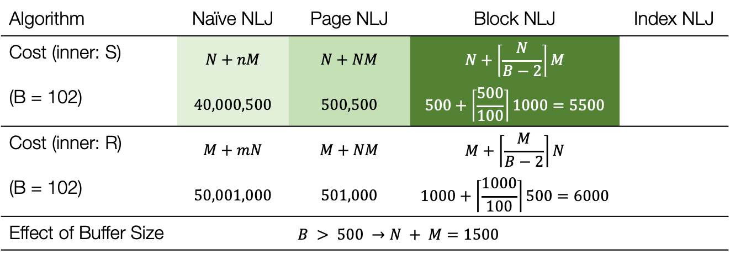
Cost Analysis – Block NLJ
Algorithm | Naïve NLJ | Page NLJ | Block NLJ | Index NLJ
Cost (inner: S) | $$N+nM$$ | $$N+NM$$ | $$N+\left\lceil \frac{N}{B−2}\right\rceil M$$
(B = 102) | $$40,000,500$$ | $$500,500$$ | $$500+\left\lceil \frac{500}{100}\right\rceil 1000=5500$$
Cost (inner: R) | $$M+mN$$ | $$M+NM$$ | $$M+\left\lceil \frac{M}{B−2}\right\rceil N$$
(B = 102) | $$50,001,000$$ | $$501,000$$ | $$1000+\left\lceil \frac{1000}{100}\right\rceil 500=6000$$
Effect of Buffer Size | $$B > 500 →N + M=1500$$ | $$B > 500 →N + M$$
R – Loans
(sid, eid, date, duration, …)
$$N = 500$$
$$n = 40,000$$
Tuples per page: $80$
S – Students
(sid, name, major, …)
$$M = 1000$$
$$m = 100,000$$
Tuples per page: $100$
B buffer size
$$B≤102$$
Even better implementation but …
What if we have an index on the inner relation?

Slide 20
Index Nested Loops Join
Cost of a Lookup
for each tuple r in R:
s = lookup(key(r), index(S))
if(s):
emit(r, s)
Index traversal
Height of a tree (2-4)
+ Find page in file by RID
+ 1
Multiple matches
Index traversal +
# of matching pages
Index traversal +
# of matching tuples

Slide 21
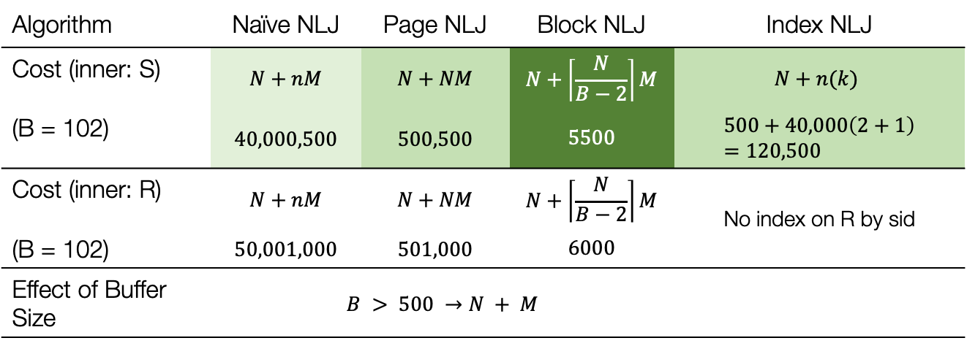
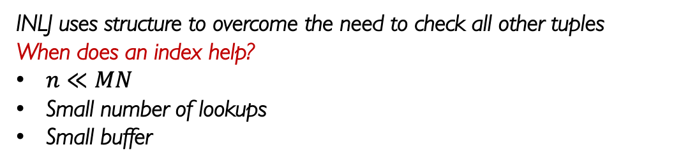
Cost Analysis – Index NLJ
Algorithm | Naïve NLJ | Page NLJ | Block NLJ | Index NLJ
Cost (inner: S) | $$N+nM$$ | $$N+NM$$ | $$N+\left\lceil \frac{N}{B−2}\right\rceil M$$ | $$N+n(k)$$
(B = 102) | $$40,000,500$$ | $$500,500$$ | $$5500$$ | $$500+40,000\left(2+1\right)=120,500$$
Cost (inner: R) | $$N+nM$$ | $$N+NM$$ | $$N+\left\lceil \frac{N}{B−2}\right\rceil M$$ | No index on R by sid
(B = 102) | $$50,001,000$$ | $$501,000$$ | $$6000$$
Effect of Buffer Size | $$B > 500 →N + M$$ | $$B > 500 →N + M$$
R – Loans
(sid, eid, date, duration, …)
$$N = 500$$
$$n = 40,000$$
Tuples per page: $80$
S – Students
(sid, name, major, …)
$$M = 1000$$
$$m = 100,000$$
Tuples per page: $100$
B buffer size
$$B≤102$$
Compute the full cross product: Quadratic!
Linear
INLJ uses structure to overcome the need to check all other tuples
When does an index help?
$n≪MN$
Small number of lookups
Small buffer

Slide 23
Sort-Merge Join

Slide 24
Sort-Merge Join
1
1
z, …
a, …
f, …
a, …
Sort R, S on join key using external merge sort
Scan sorted files and “merge”
r, …
c, …
1
1
a, …
a, …
2
2
a, …
d, …
b, …
a, …
d, …
f, …
p, …
b, …
w, …
f, …
2
2
w, …
b, …
3
3
p, …
p, …
b, …
c, …
x, …
p, …
c, …
p, …
f, …
r, …
3
3
a, …
p, …
4
4
p, …
w, …
p, …
w, …
c, …
x, …
x, …
x, …
a, …
z, …
R
# of pages: N
# of tuples: n
S
# of pages: M
# of tuples: m

Slide 25



Sort-Merge Join – Merge Pass
left-cursor
right-cursor
right-base
1
do{
  key(left-cursor) == key(right-base):
  right-cursor = right-base
  do{
    emit(r, s)
    advance(right-cursor)
  } while(key(left-cursor) == key(right-cursor))
  advance left-cursor
  key(left-cursor) > key(right-base):
  if(right-cursor > right-base):
    right-base = right-cursor
  else
    advance(right-base, right-cursor)
  key(left-cursor) < key(right-base):
  advance(left-cursor)
}
while(left-cursor != EOF)
1
a,a …
a, …
a, …
a, …
a, …
a,a …
c, …
b, …
a,a …
2
2
a,a …
d, …
$$==$$
b, …
f, …
c, …
c,c …
f, …
p, …
p,p …
3
3
p,p …
p, …
p, …
p, …
w, …
p,p …
r, …
x, …
p,p …
4
$$>$$
R
w,w…
w, …
x,x…
x, …
z, …
S
$$<$$

Slide 26


Cost Analysis – Merge Join
R – Loans
(sid, eid, date, duration, …)
$$N = 500$$
$$n = 40,000$$
Tuples per page: $80$
S – Students
(sid, name, major, …)
$$M = 1000$$
$$m = 100,000$$
Tuples per page: $100$
B buffer size
$$B≤102$$
Assuming files are sorted
Best Case Cost:
$$N+M$$
Single scan advancing cursors left and right!
Equality Join with no duplicates!
Linear!
Worst Case Cost:
$$nM$$
Effectively a nested loop join
Single duplicate key on both sides === a cross product! (very unlikely)
Quadratic!

Slide 27
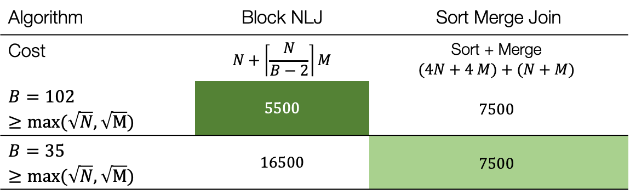
Cost Analysis – SMJ
R – Loans
(sid, eid, date, duration, …)
$$N = 500$$
$$n = 40,000$$
Tuples per page: $80$
S – Students
(sid, name, major, …)
$$M = 1000$$
$$m = 100,000$$
Tuples per page: $100$
B buffer size
$$B≤102$$
Algorithm | Block NLJ | Sort Merge Join
Cost | $$N+\left\lceil \frac{N}{B−2}\right\rceil M$$ | Sort + Merge $$(4N+4 M)+(N+M)$$
$$B=102≥max⁡(\sqrt{N}, \sqrt{M})$$ | $$5500$$ | $$7500$$
$$B=35≥max⁡(\sqrt{N}, \sqrt{M})$$ | $$16500$$ | $$7500$$
But we can do better if we can integrate merge join within the sort pass!

Slide 28
Sort-Merge Join (No Refinement)
Unsorted input relations
Sort Phase
(Ext. Merge Sort)
R
S
Split & sort
Split & sort
Merge
Merge
Merge / Join Phase
Joined output file created!
Slide Credit: https://thodrek.github.io/cs564-fall17/lectures/lecture-17/Lecture_17_Joins.pdf

Slide 29

Sort-Merge Join (With Refinement)
Unsorted input relations
Given B buffer pages
Sort Phase
(Ext. Merge Sort)
R
S
Split & sort
Split & sort
<= B-1 total sorted runs
B-way Merge / Join
Merge / Join Phase
Joined output file created!
How big is B for this optimization? $B≥\sqrt{N}+\sqrt{M}$
Slide Credit: https://thodrek.github.io/cs564-fall17/lectures/lecture-17/Lecture_17_Joins.pdf

Slide 30
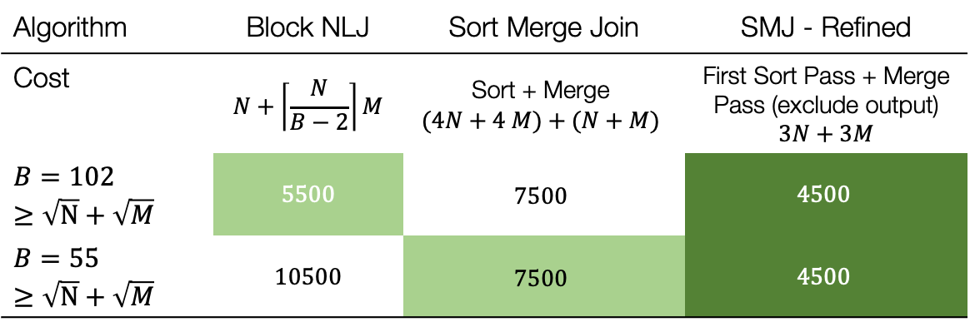
Cost Analysis – SMJ
R – Loans
(sid, eid, date, duration, …)
$$N = 500$$
$$n = 40,000$$
Tuples per page: $80$
S – Students
(sid, name, major, …)
$$M = 1000$$
$$m = 100,000$$
Tuples per page: $100$
B buffer size
$$B≤102$$
Algorithm | Block NLJ | Sort Merge Join | SMJ - Refined
Cost | $$N+\left\lceil \frac{N}{B−2}\right\rceil M$$ | Sort + Merge $$(4N+4 M)+(N+M)$$ | First Sort Pass + Merge Pass (exclude output) $$3N+3M$$
$$B=102≥\sqrt{N}+\sqrt{M}$$ | $$5500$$ | $$7500$$ | $$4500$$
$$B=55≥\sqrt{N}+\sqrt{M}$$ | $$10500$$ | $$7500$$ | $$4500$$

Slide 32
Grace Hash Join

Slide 33
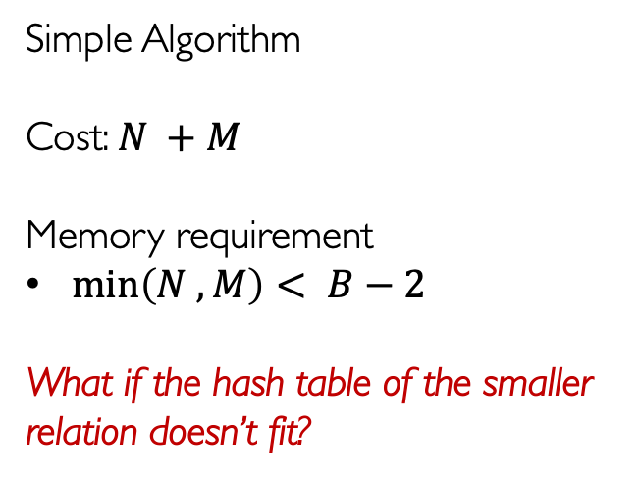
Naïve Hash Join
Simple Algorithm
Cost: $N +M$
Memory requirement
$\min\left(N , M\right)< B−2$
What if the hash table of the smaller relation doesn’t fit?
…
1
Scan
1
z, …
h(k) | v
0 | b,…
1 | p,… p,…
2 | a,… a,…
3 | x,…
4 | w,…
5
6 | c,…
Probe
z, …
f, …
f, …
r, …
1
r, …
a, …
b, …
2
2
a, …
In
a, …
p, …
d, …
d, …
w, …
2
w, …
w, …
3
b, …
3
p, …
p, …
c, …
Out
a,a …
x, …
p,p …
x, …
a,a …
p,p …
a,a …
p,p …
a,a …
p,p …
f, …
3
f, …
a, …
w,w…
x,x…
c,c…
4
p, …
4
p, …
p, …
x, …
c, …
c, …
a, …
a, …
3
3
3
3
a,a …
p,p …
p,p …
a,a …
Build in-memory hash table of size (B-2) using hashing function h(k)
a,a …
p,p …
p,p …
a,a …
w,w…
x,x…
c,c…

Slide 34

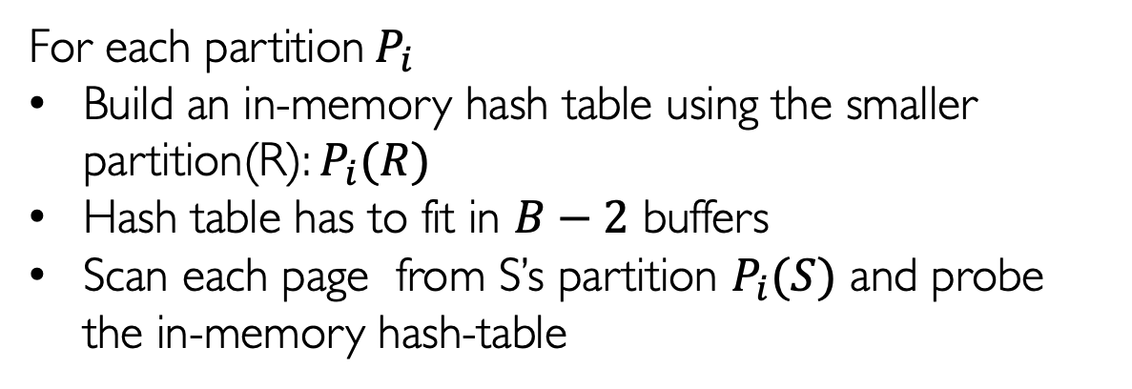
Divide / Partition Phase
Use a partitioning hash function to divide each table into $B−1$ uniform partitions
Conquer Phase
For each partition$P_{i}$
Build an in-memory hash table using the smaller partition(R): $P_{i}(R)$
Hash table has to fit in $B−2$ buffers
Scan each page from S’s partition $P_{i}(S)$ and probe the in-memory hash-table
Grace Hash Join

Slide 35
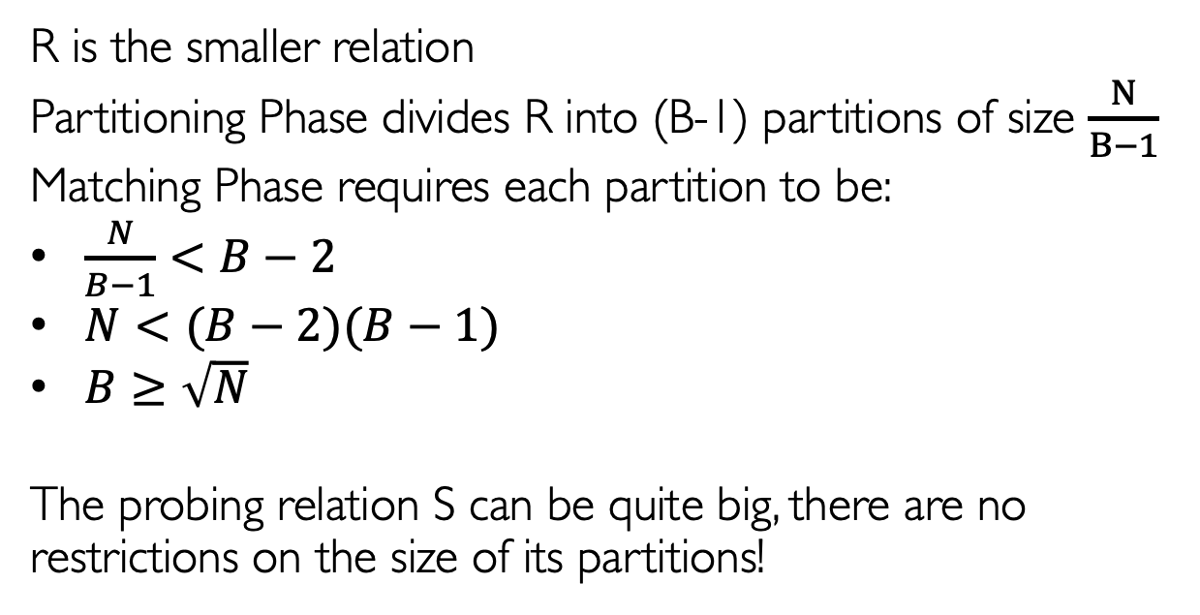
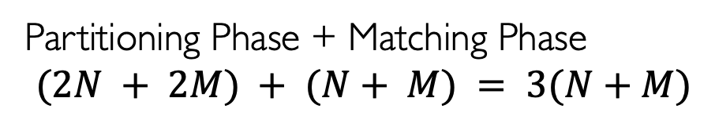
Cost
Partitioning Phase + Matching Phase
$$(2N + 2M) + (N+ M) = 3(N+M)$$
Memory Requirement
R is the smaller relation
Partitioning Phase divides R into (B-1) partitions of size $\frac{N}{B−1}$
Matching Phase requires each partition to be:
$\frac{N}{B−1}<B−2$
$N<(B−2)(B−1)$
$B≥\sqrt{N}$
The probing relation S can be quite big, there are no restrictions on the size of its partitions!
Cost and Memory Analysis of Grace Hash Join

Slide 36
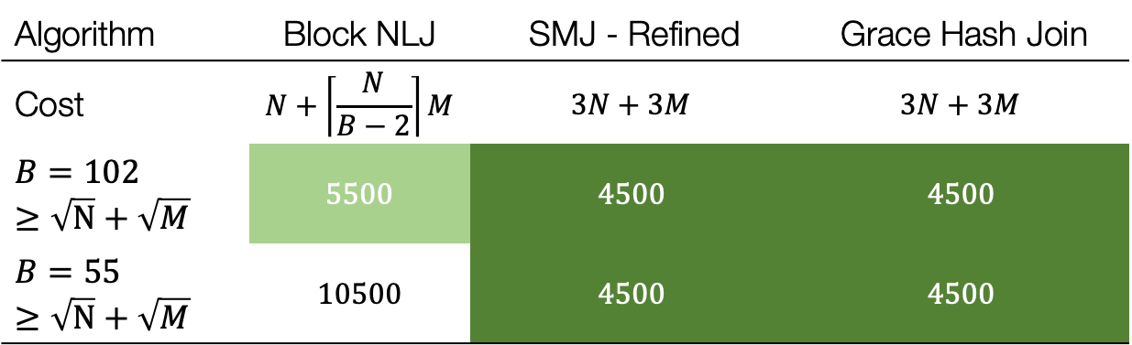
Cost Analysis – Grace Hash Join
R – Loans
(sid, eid, date, duration, …)
$$N = 500$$
$$n = 40,000$$
Tuples per page: $80$
S – Students
(sid, name, major, …)
$$M = 1000$$
$$m = 100,000$$
Tuples per page: $100$
B buffer size
$$B≤102$$
Algorithm | Block NLJ | SMJ - Refined | Grace Hash Join
Cost | $$N+\left\lceil \frac{N}{B−2}\right\rceil M$$ | $$3N+3M$$ | $$3N+3M$$
$$B=102≥\sqrt{N}+\sqrt{M}$$ | $$5500$$ | $$4500$$ | $$4500$$
$$B=55≥\sqrt{N}+\sqrt{M}$$ | $$10500$$ | $$4500$$ | $$4500$$

Slide 37
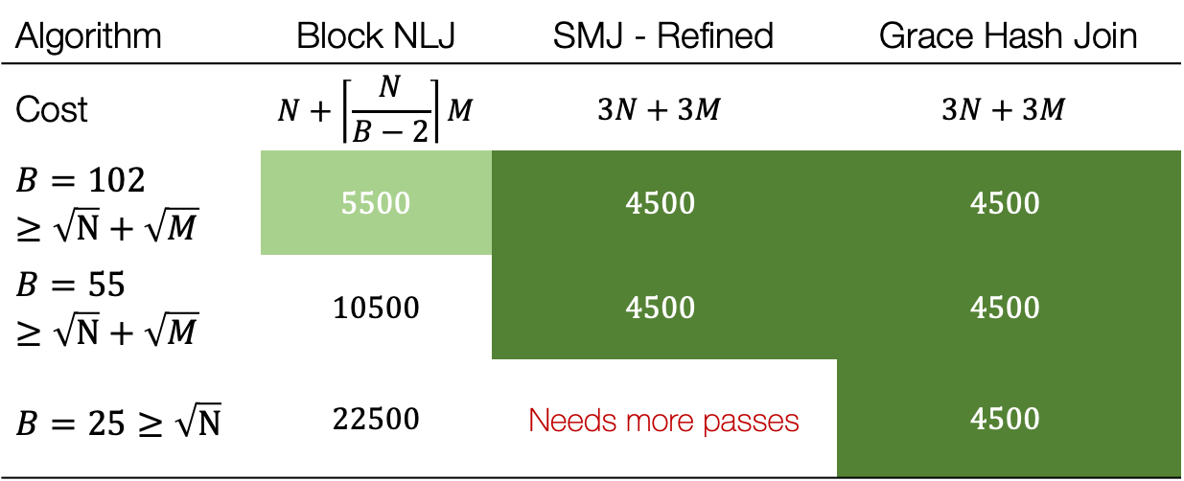
Cost Analysis – Grace Hash Join
R – Loans
(sid, eid, date, duration, …)
$$N = 500$$
$$n = 40,000$$
Tuples per page: $80$
S – Students
(sid, name, major, …)
$$M = 1000$$
$$m = 100,000$$
Tuples per page: $100$
B buffer size
$$B≤102$$
Algorithm | Block NLJ | SMJ - Refined | Grace Hash Join
Cost | $$N+\left\lceil \frac{N}{B−2}\right\rceil M$$ | $$3N+3M$$ | $$3N+3M$$
$$B=102≥\sqrt{N}+\sqrt{M}$$ | $$5500$$ | $$4500$$ | $$4500$$
$$B=55≥\sqrt{N}+\sqrt{M}$$ | $$10500$$ | $$4500$$ | $$4500$$
$$B=25≥\sqrt{N}$$ | $$22500$$ | Needs more passes | $$4500$$

Slide 39
Summary

Slide 40
Visual Comparison – BNLJ, SMJ vs. GHJ
The Grace Hash Join partitioning breaks down the grid into smaller grids for further matching
The SMJ uses order to avoid searching the whole grid and establishing search boundaries
a
a
b
c
p
p
w
x
 | a | a | c | d | f | f | p | p | r | w | x | z
BNLJ doesn’t take advantage of structure – we explore the whole grid for matches!

Slide 41
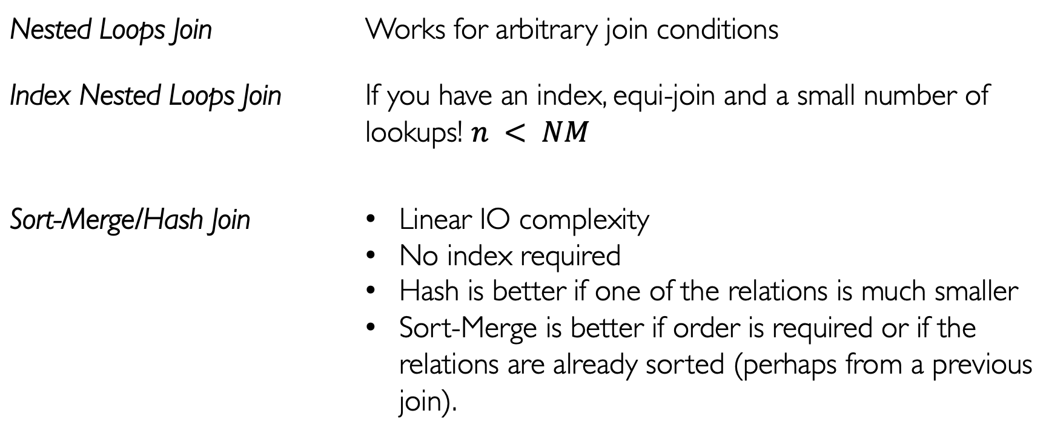
Key Takeaways
Nested Loops Join | Works for arbitrary join conditions
Index Nested Loops Join | If you have an index, equi-join and a small number of lookups! $n < NM$
Sort-Merge/Hash Join | Linear IO complexity No index required Hash is better if one of the relations is much smaller Sort-Merge is better if order is required or if the relations are already sorted (perhaps from a previous join).
A typical DBMS implements all of these and uses a query optimizer to select the best join for a given query plan!

